Slide 1
24MAT120
S2 P & M

Slide 2
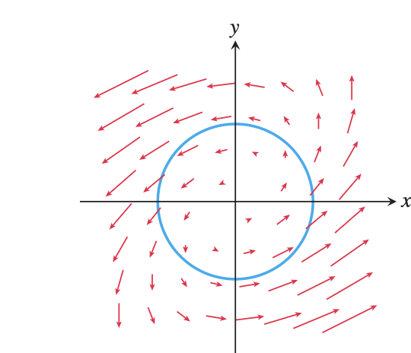
Now we move from force fields to velocity fields, where line integrals describe how fluids move.
This is the real intuition behind:
Circulation
Flux
Green’s theorem

Slide 3
A velocity field assigns a velocity vector to every point.
Interpretation:
  direction → flow direction
  magnitude → flow speed
Examples:
water flow
wind
air currents

Slide 4
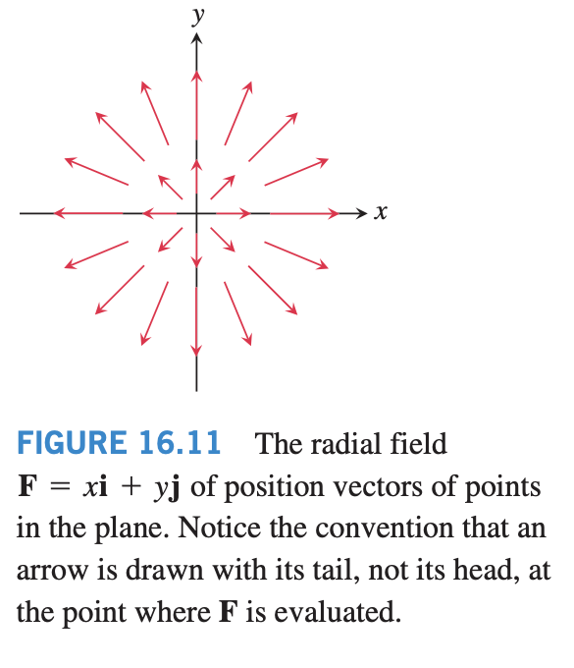
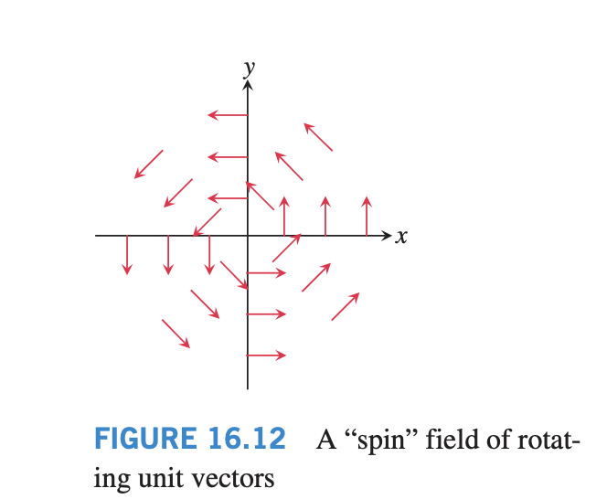
Suppose that F represents the velocity field of a fluid flowing through a region in space (a tidal basin or the turbine chamber of a hydroelectric generator, for example).
Under these circumstances, the integral of F.T along a curve in the region gives the fluid’s flow along, or circulation around, the curve.
For instance, the vector field in Figure 16.11 gives zero circulation around the unit circle in the plane.
By contrast, the vector field in Figure 16.12 gives a nonzero circulation around the unit circle.

Slide 5
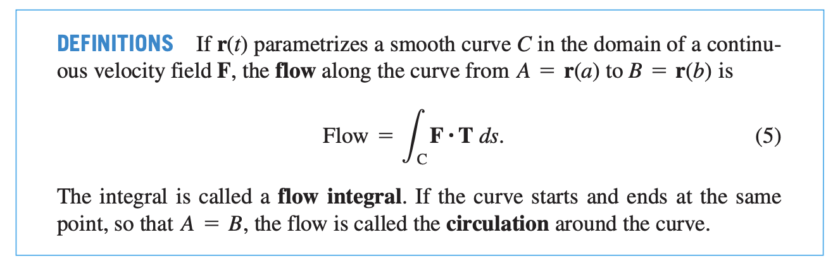

Slide 6
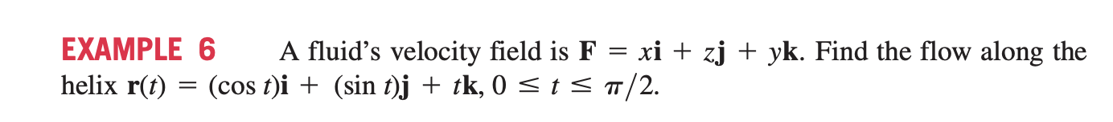
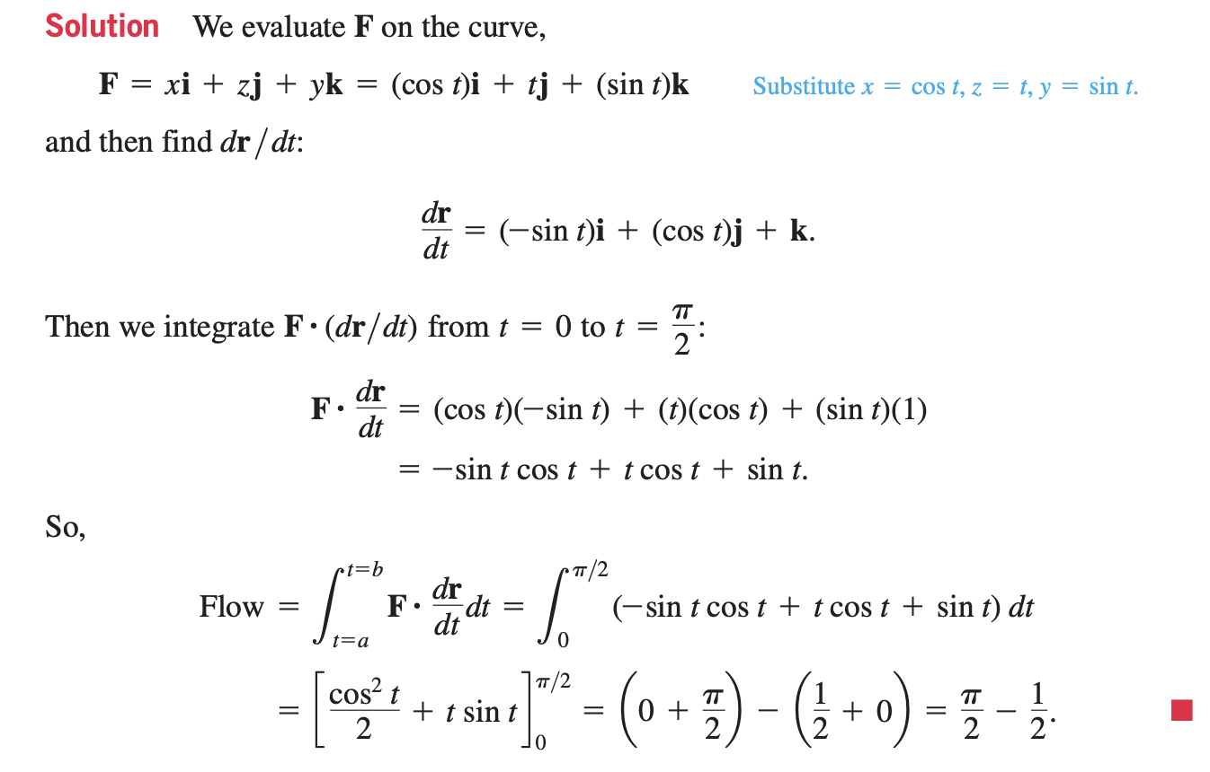

Slide 7
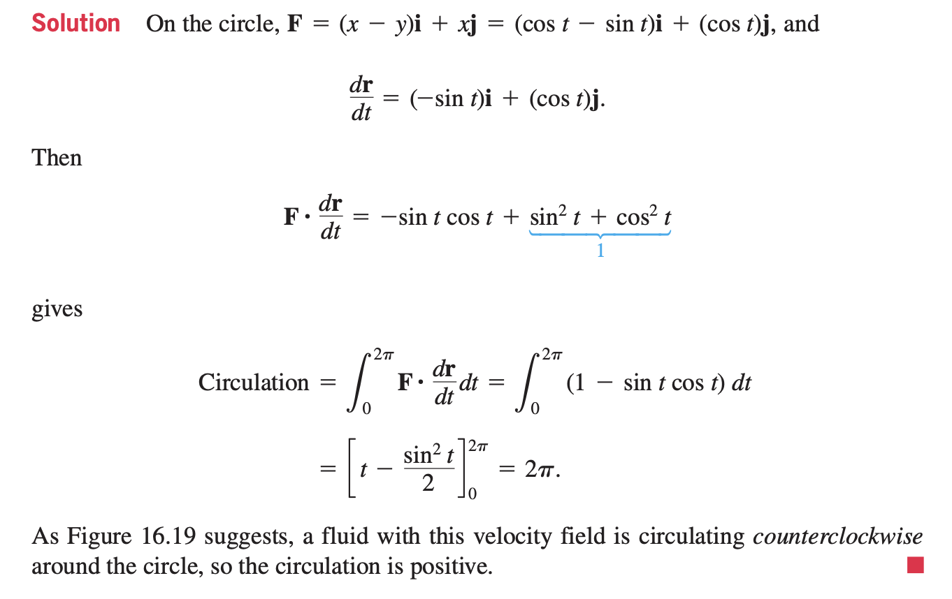
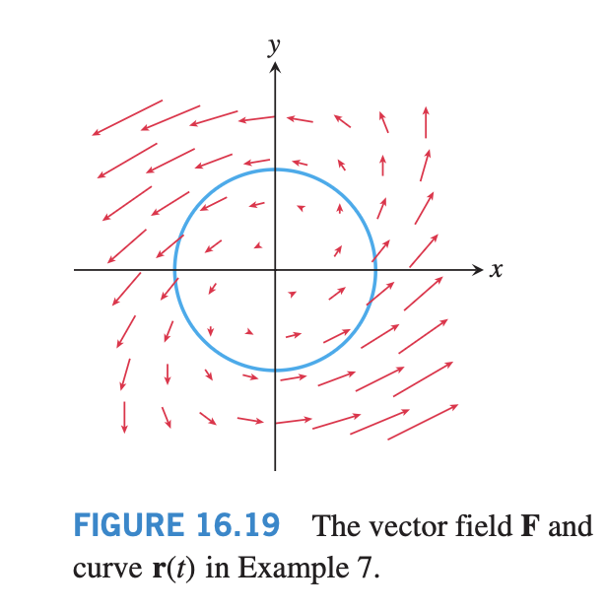

Slide 8
Flux Across a Simple Closed Plane Curve
To find the rate at which a fluid is entering or leaving a region enclosed by a smooth simple closed curve C in the xy-plane, we calculate the line integral over C of F.n, the scalar component of the fluid’s velocity field in the direction of the curve’s outward-pointing normal vector.
We use only the normal component of F, while ignoring the tangential component, because the normal component leads to the flow across C.
The value of this integral is the flux of F across C. Flux is Latin for flow.

Slide 9
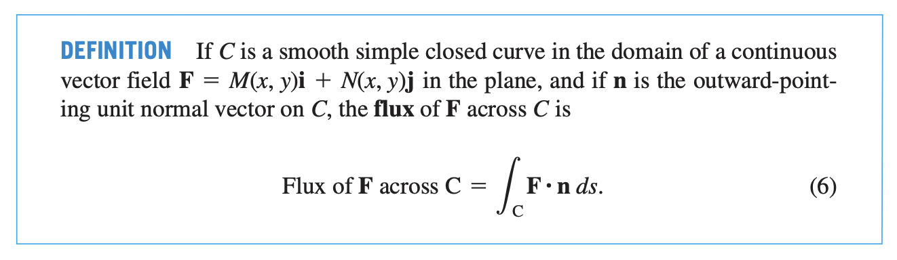

Slide 10
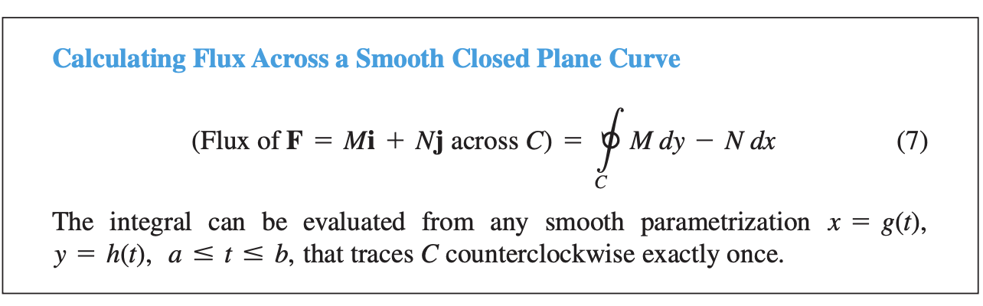

Slide 11
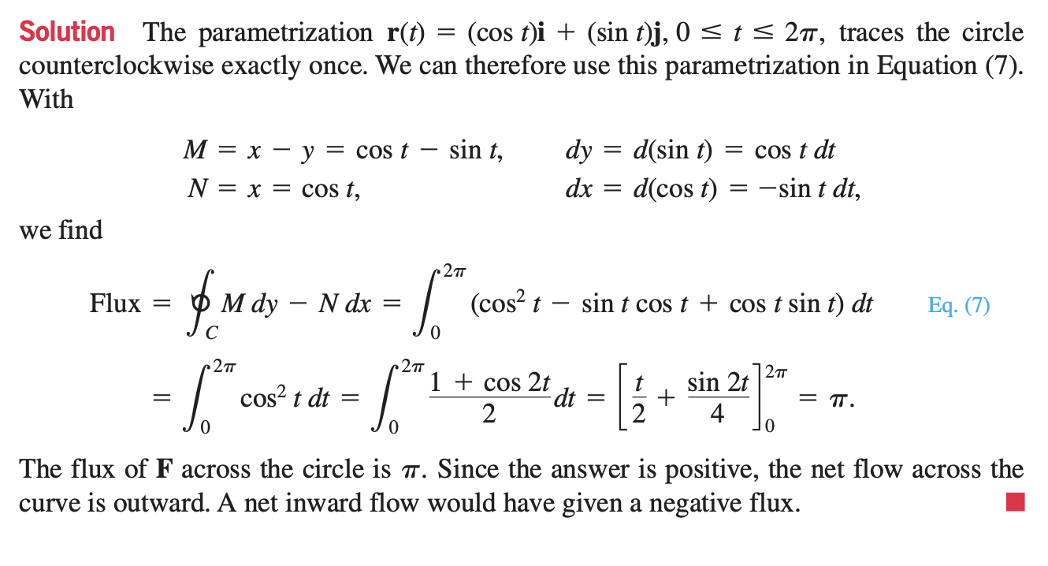

Slide 12
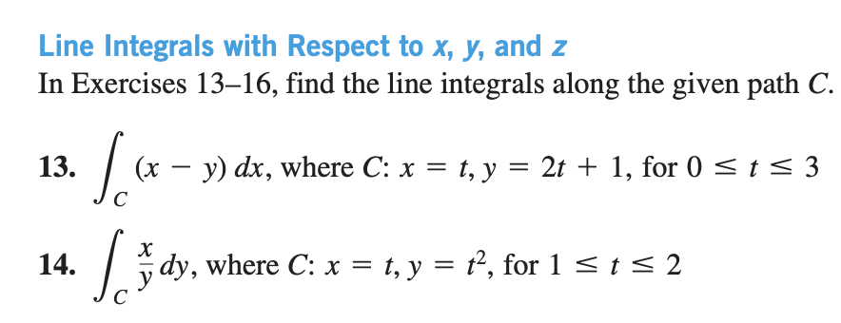

Slide 13
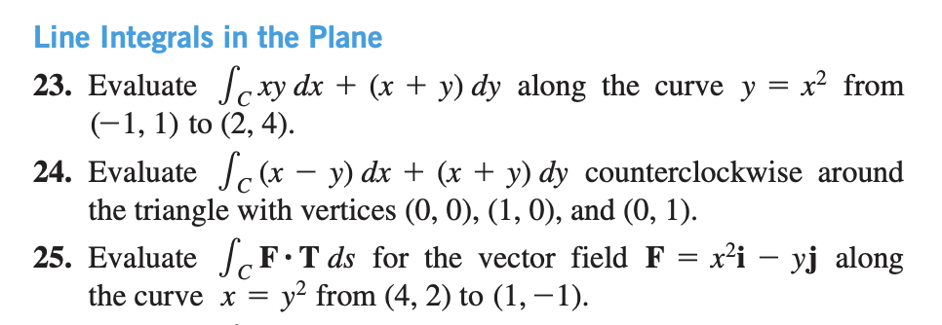

Slide 14
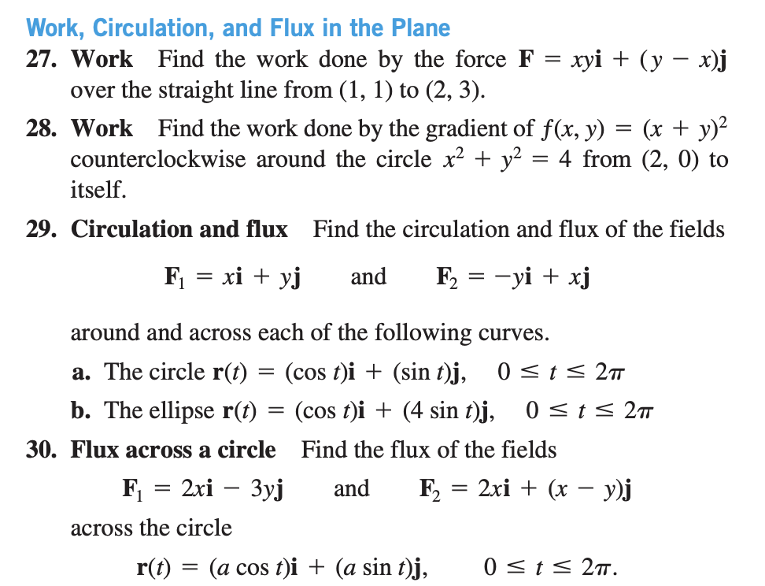

Slide 15
